Slide 1
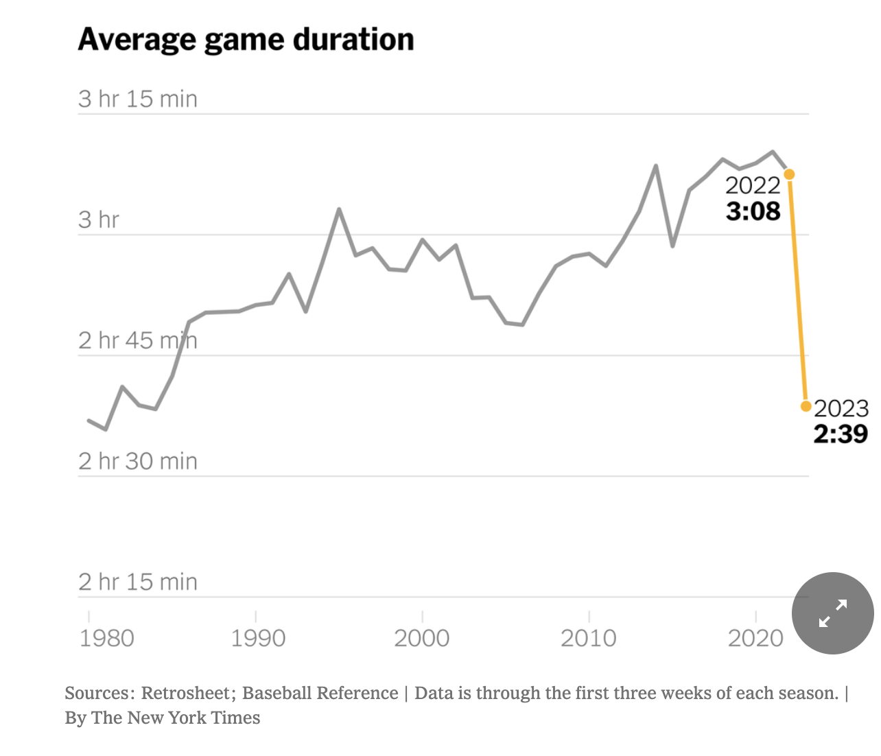
Data Analysis and Interpretation

Slide 2
In the Lesson you will:
Identify reasons adults (and students) need to be able to interpret and analyze data and graphs
Practice identifying patterns in data to describe and explain phenomena.
At the end of the lesson you will be able to:
Complete a pre assessment on the standard: I can analyze and interpret data to describe a scientific phenomena.

Slide 3
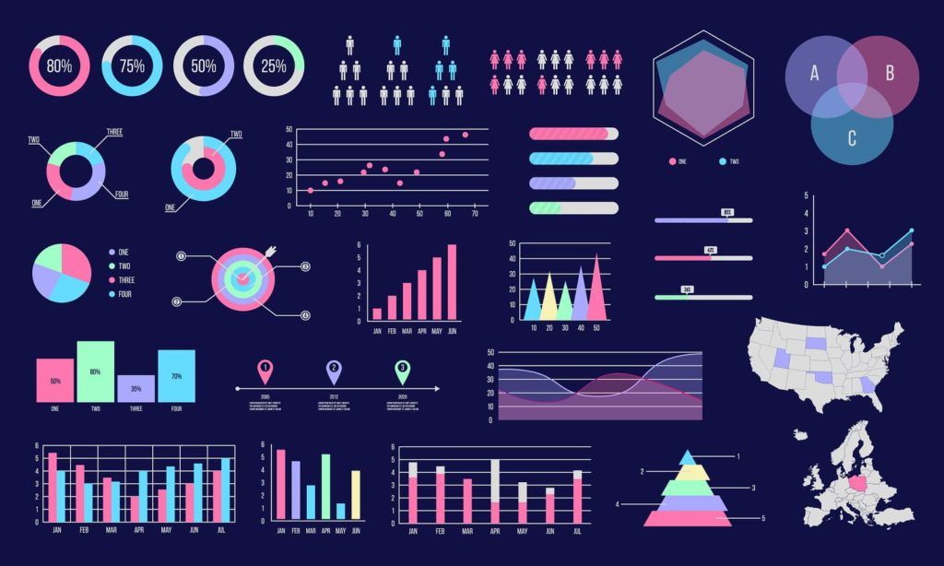
Talk with your elbow partner:
Why is it important for people to know how to read data?
Do you know of ways that data can be used for harm or for bad? 😱
Graphic from BoostLabs
Be prepared to share with the class!

Slide 4
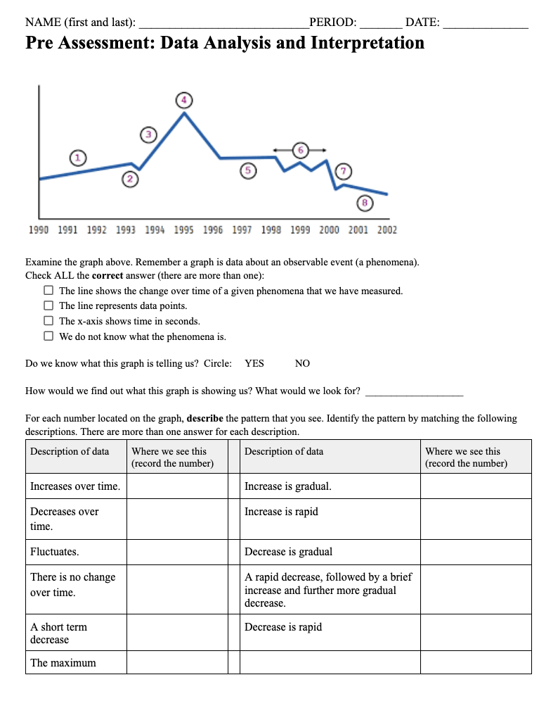
Pre Assessment:
Put your name, date and period number on your Pre Assessment.
Complete page one. We will review the answers together.
We will pre read the data graphs on the next page. You will have time to work through on your own and we will review as a class.
Please stay seated for the class period. Have your voices off when the teacher is talking.
Tomorrow you will begin your Assessment. This will be individual work.
Notes:
Force copy of pre-assessment link: https://docs.google.com/document/d/1L8ErRd4Fq2YnI6el4H8kyP4Jy4T1HK5SbtUlejvXDfE/template/preview

Slide 5
In the Lesson you will:
Identify how data is collected and coded using data from return rates of the Chinook salmon at Bonneville Dam.
Apply your skills of analysis to describe the patterns in Chinook salmon return rates on the Columbia River.
Use your research knowledge to interpret why we see the pattern in population change of salmon in the Columbia River.
At the end of the lesson you will be able to:
Complete an assessment on the standard: I can analyze and interpret data to describe a scientific phenomena.

Slide 6
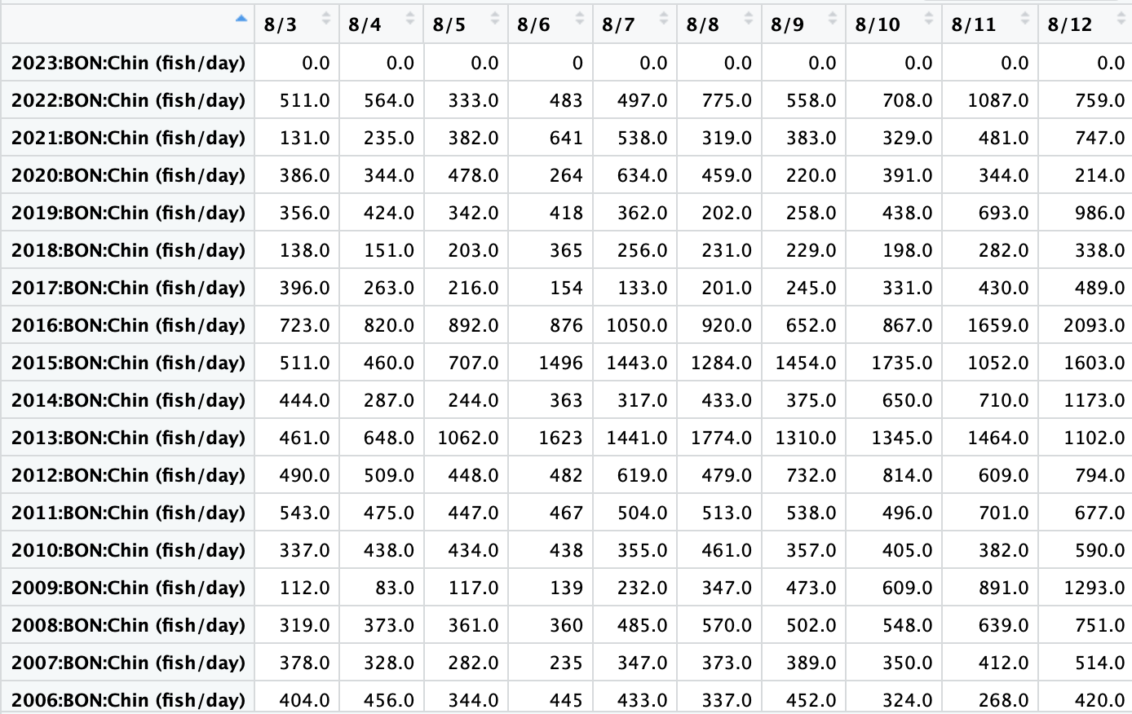

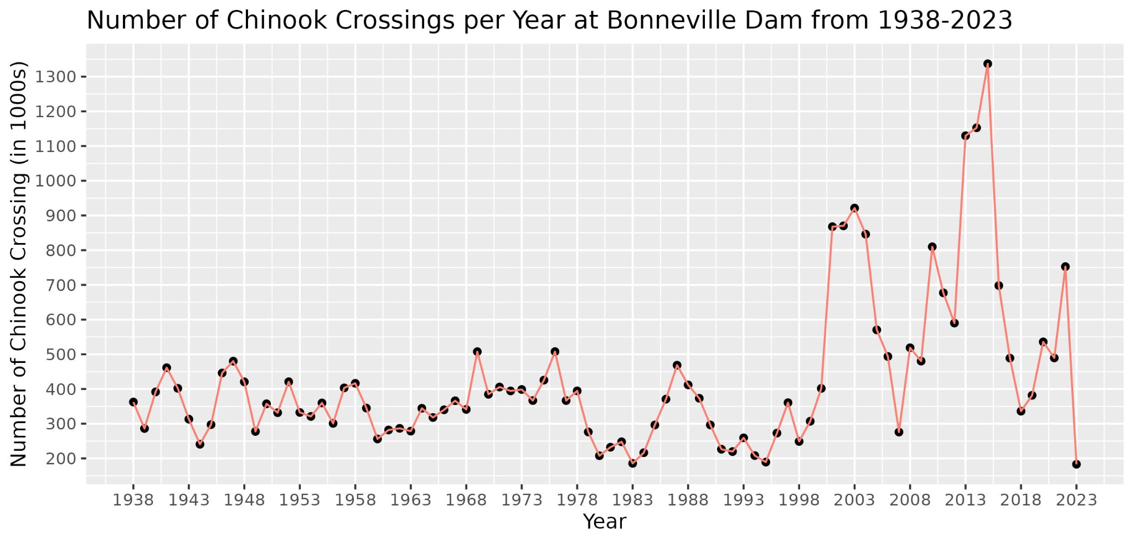
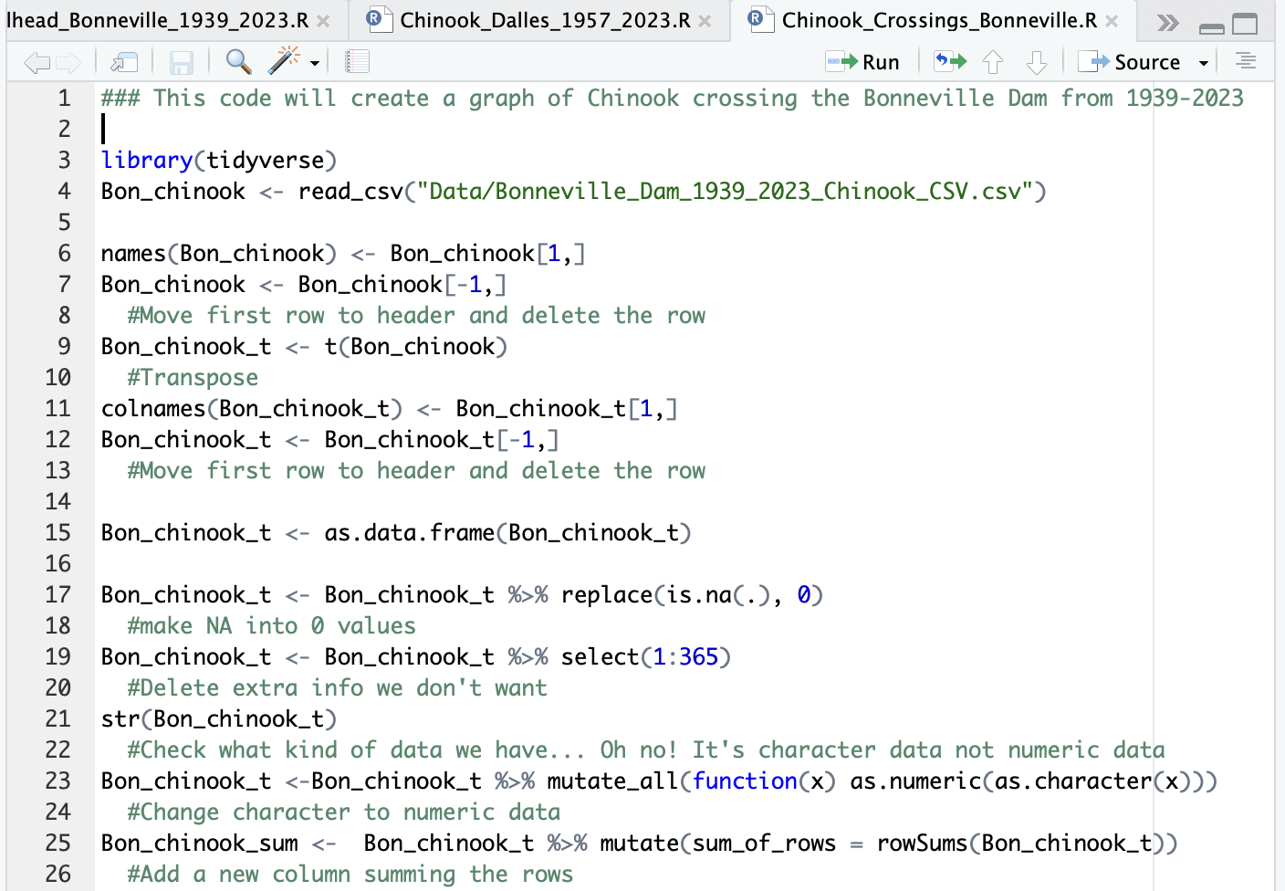
Overview of how coding works:

Slide 7

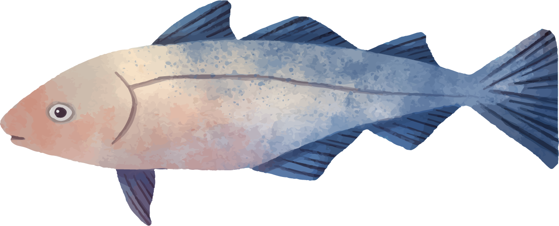
Computer Coding!
Goal: Move your partner to a chair with only these commands:
1 step Forward
1 step Backward
1 step Left
1 step Right
Sit down
What if we were like computers and only understood specific commands???
Notes:
Handout: https://docs.google.com/document/d/1KGzwHzc2LCTbUm1vFHBk8IoVLK9XhPlOgybvhabctI4/template/preview

Slide 8
Discussion Questions
What were some challenges when you pretended to be a computer?
What was easy about the activity?
Do you think a computer works similarly to how you worked with your partner in this activity? How?
Notes:
Handout: https://docs.google.com/document/d/1KGzwHzc2LCTbUm1vFHBk8IoVLK9XhPlOgybvhabctI4/template/preview

Slide 9
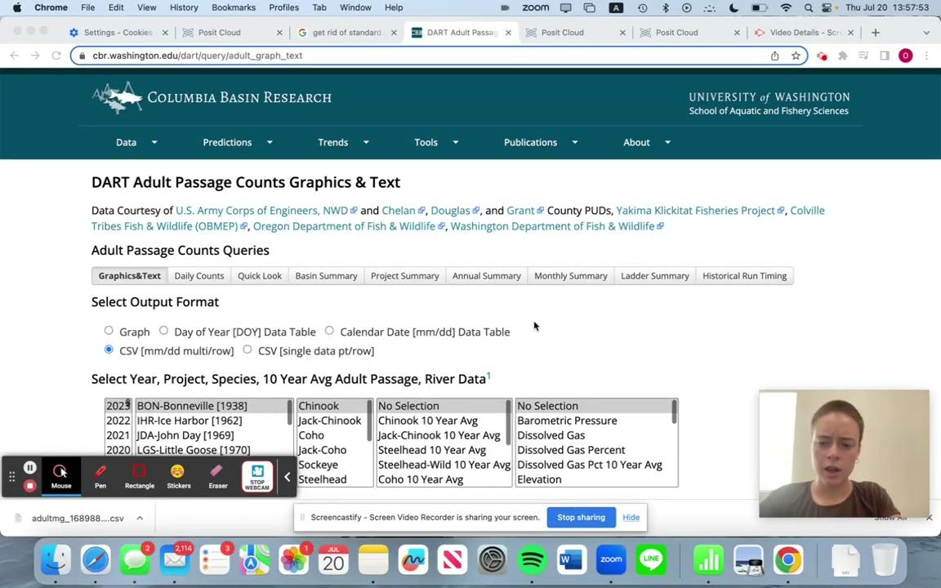
Review:
How was the graph made? Lewis and Clark student, Olivia Spagnuolo created this graph during a workshop with me this summer. Here she is explaining how she coded the data.

Slide 10
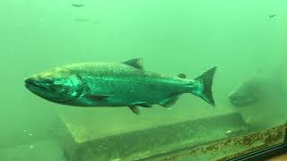
Salmon returning
Fish seen through the fish ladder at Bonneville dam.

Slide 11
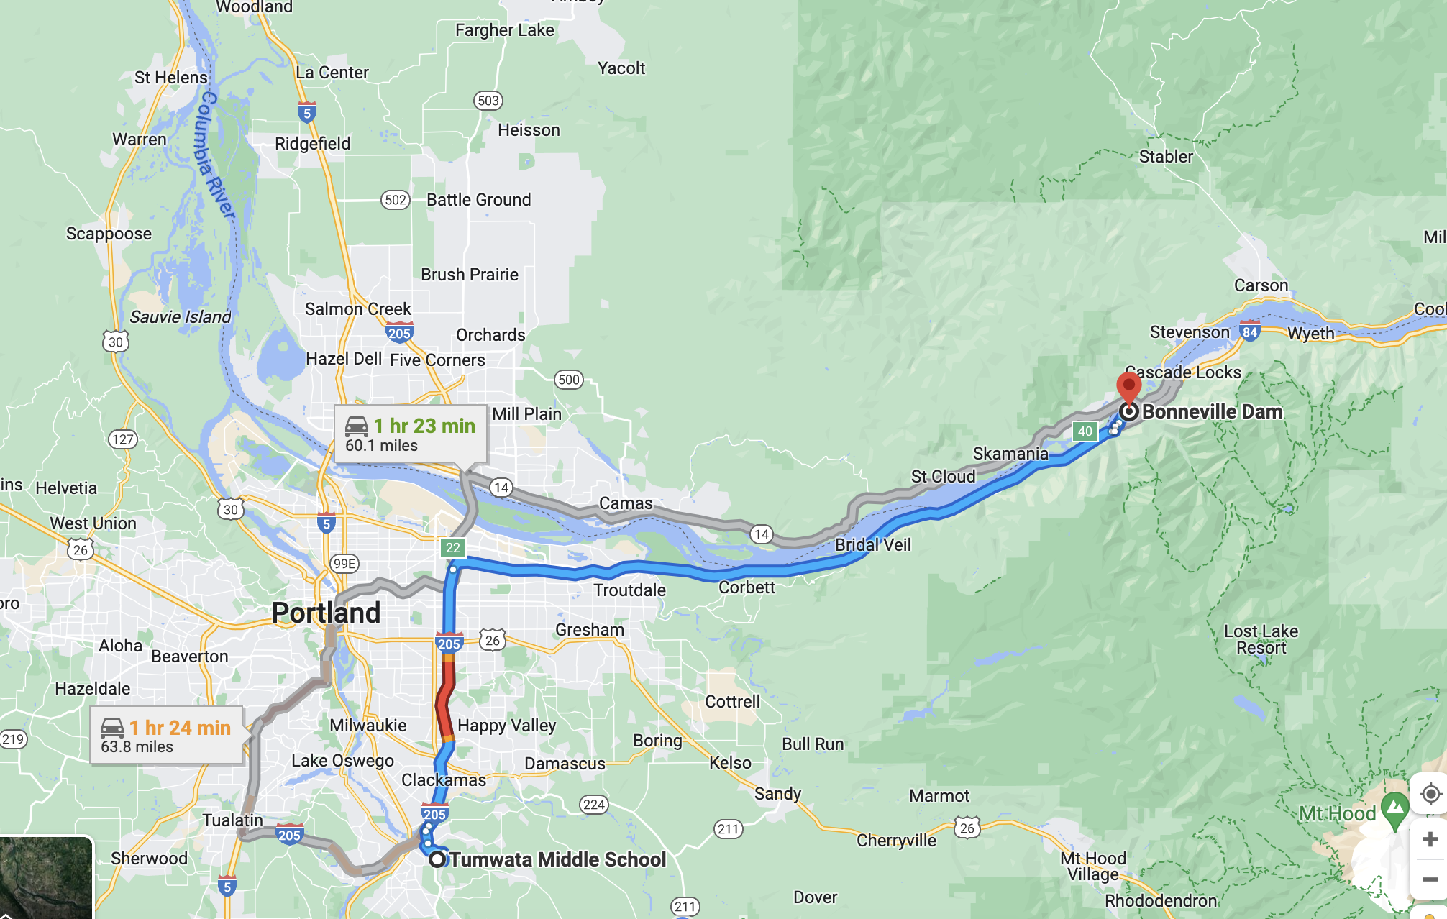
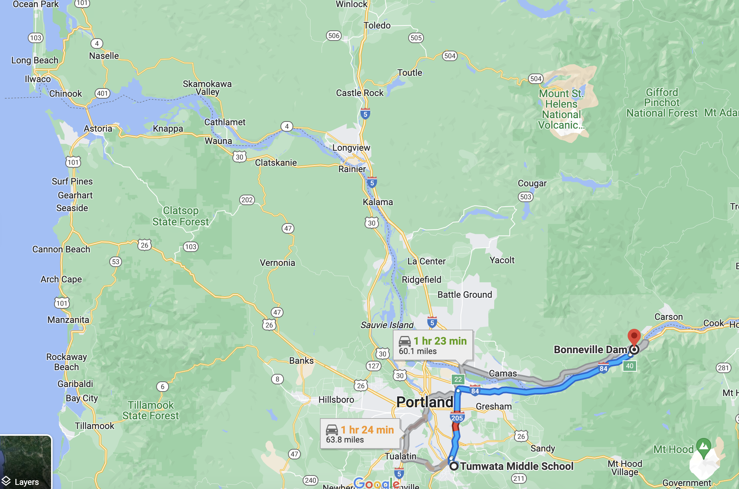
Review:
Before we begin the assessment, let’s look at a few ideas.
Where is the Bonneville Dam, Columbia River?
Why would salmon be “returning”? What do we mean by this?
What would salmon be “crossing”? What do we mean by chinook crossing per year?

Slide 12
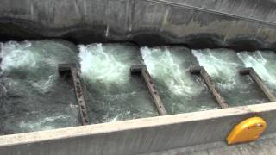
How do we know how many salmon are returning?
Let’s look at the data. The source data is from this website. https://www.cbr.washington.edu/dart
How do we know how many chinook salmon are coming back? Who is counting them!?
Let’s watch to understand fish passage at Bonneville Dam.

Slide 13


How do we know how many salmon are returning?
How do we know how many chinook salmon are coming back? Who is counting them!?
Understanding fish passage at Bonneville Dam:

Slide 14
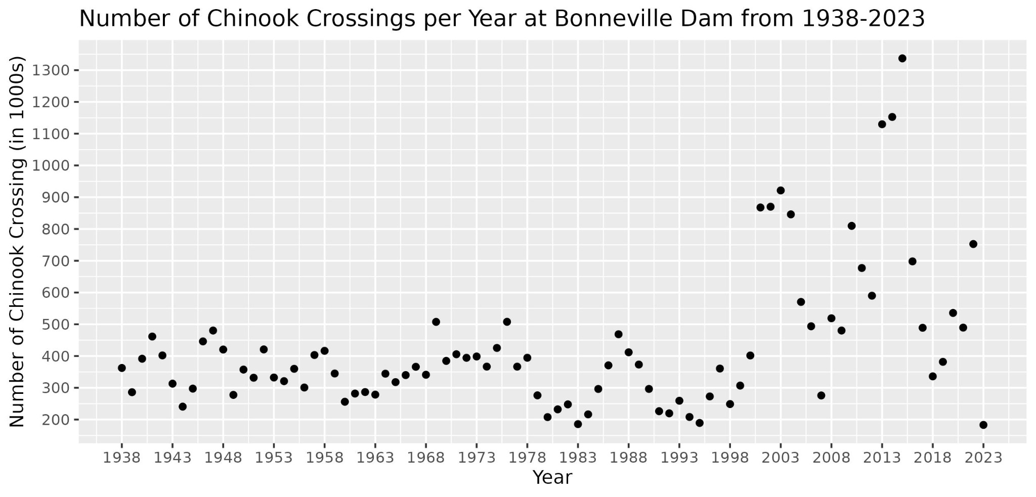
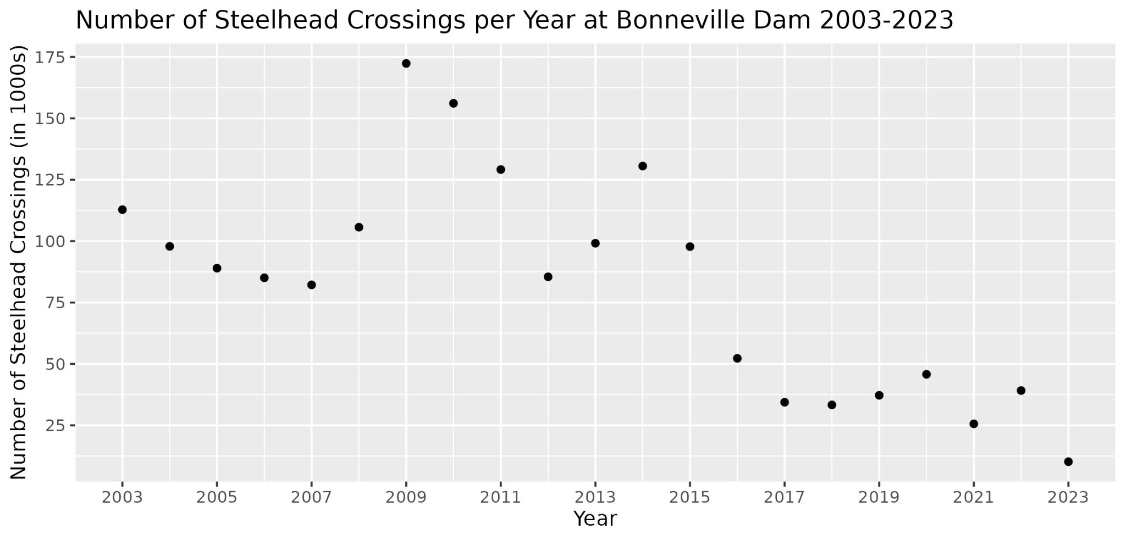
Notes:
- We have graphs from the data in R!
- Let's look at just the labels
- What is Chinook and Steelhead? What is a crossing?
- What do you see on the left axis and the bottom axis?
- Then let's look at the points, start with the flatter section in Chinook crossings
- What do you see?
- What might it mean?
- What do you wonder?
Make sure students notice: The numbers on the axes, the years
- How are the points changing?
Let's try drawing lines to connect the points

Slide 15
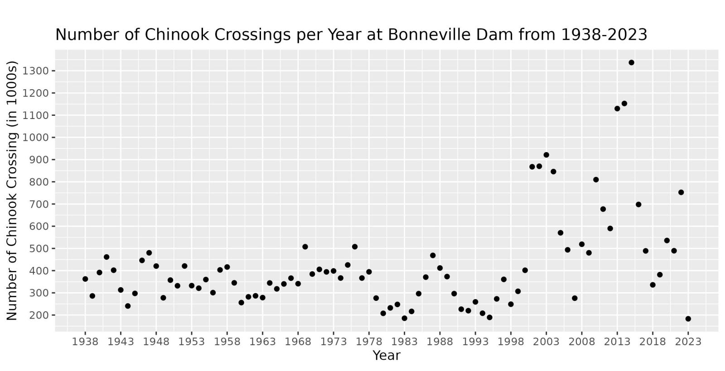
Let’s look at the data.
Write your name on the back of your graph with pencil
Notes:
Handout graphs: https://docs.google.com/document/d/1uIlFOfdUn2YK9Ntbdcj8e6EDegEH2YD9SLZuP7e5_m8/template/preview
- We have graphs from the data in R!
- Let's look at just the labels
- What is Chinook and Steelhead? What is a crossing?
- What do you see on the left axis and the bottom axis?
- Then let's look at the points, start with the flatter section in Chinook crossings
- What do you see?
- What might it mean?
- What do you wonder?
Make sure students notice: The numbers on the axes, the years
- How are the points changing?
Let's try drawing lines to connect the points

Slide 16

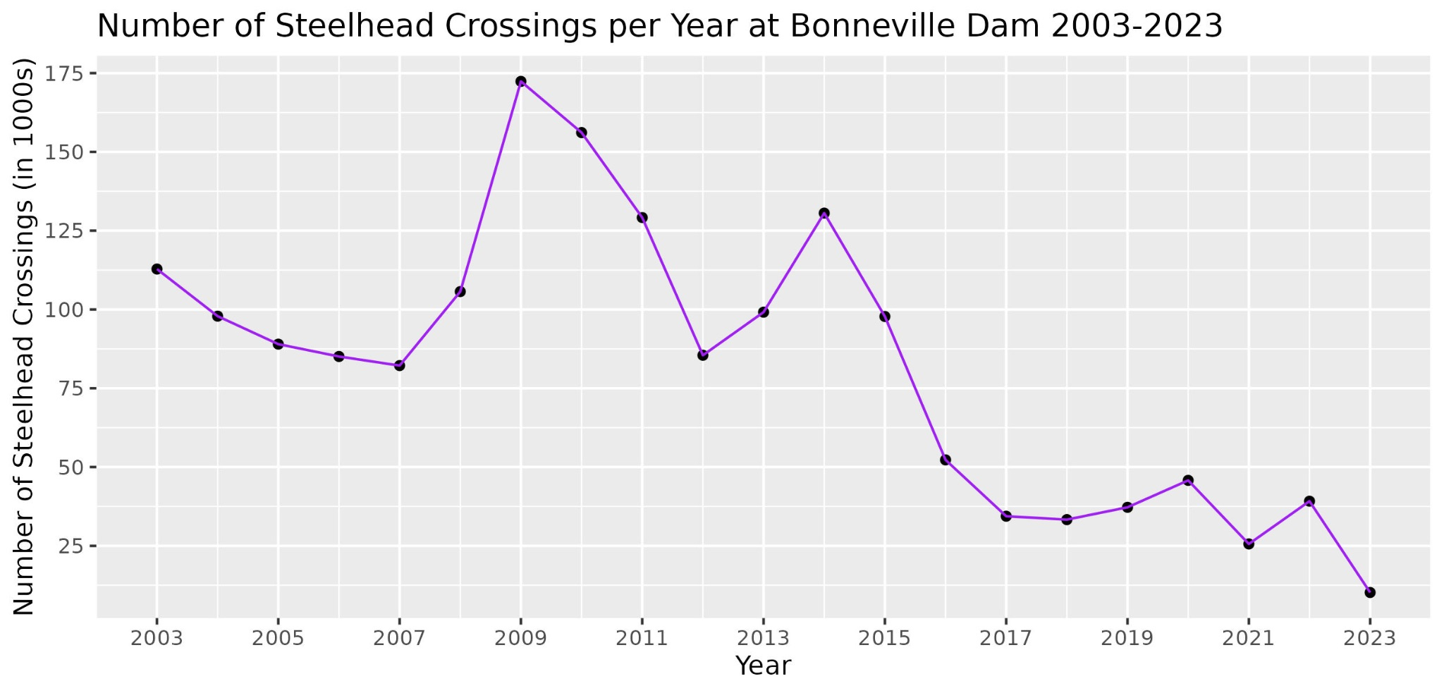
Notes:
What do you see? What does it mean? What do you wonder?
Are there more salmon or less salmon in ____ time period? (thinking point to different areas of the graph to ask about salmon there)
Do you notice line spikes? What do they mean? What do you wonder?

Slide 17
Review:
Use the information you have heard to answer the following question on the white board. Work with your table group.
How is the data we are looking at collected? How was the graph made?
You have 5 minutes to complete this work.

Slide 18
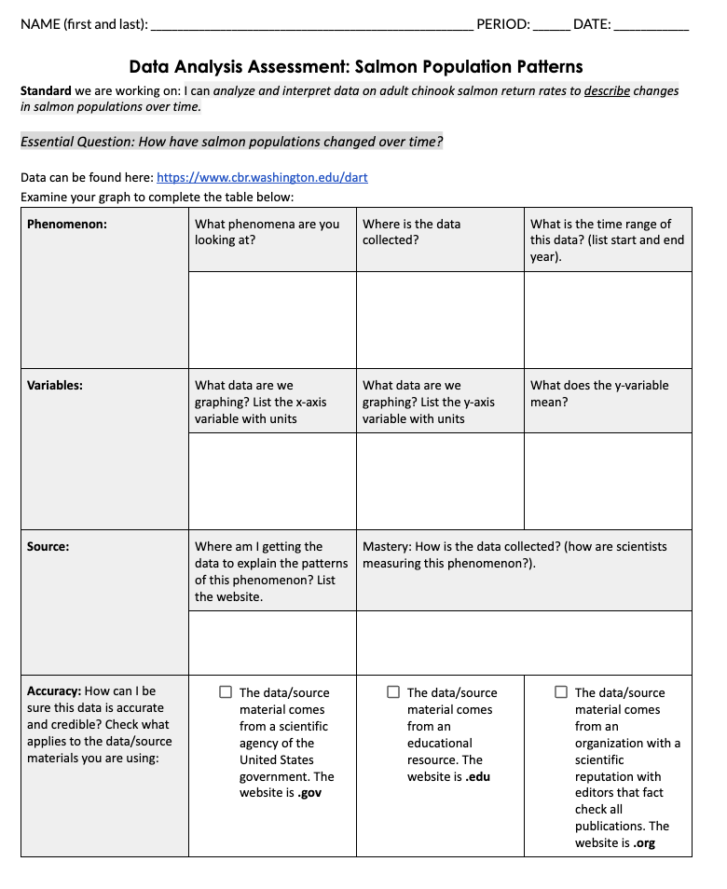
Final Assessment:
Put your name, date and period number on your Assessment.
Work Independently and SILENTLY to show your thinking.
Standard: I can analyze and interpret data on
adult chinook salmon return rates to describe changes in salmon population over time.
Let’s review the Assessment and Checklist together. Please stay silent. Raise your hand if you have a question.
Please stay seated for the class period. Have your voices off during the Assessment. Ask me for clarification.
Stay silent. Let other’s work. DUE end of class today
Notes:
Assessment: https://docs.google.com/document/d/1gSmukQIFNwuMucHjg8HNc9bRM1adVvKqDWZphJu1xAM/template/preview

Slide 19
Final Assessment:
You need a ruler and a highlighter.
Work Independently and SILENTLY to show your thinking.
Standard: I can analyze and interpret data on
adult chinook salmon return rates to describe changes in salmon population over time.
Please stay seated for the class period. Have your voices off during the Assessment. Ask me for clarification.
Stay silent. Let other’s work. DUE end of class on Friday.

